Slide 1
Lead in Drinking Water
Dr. Raymond SM Wong
Prince of Wales Hospital Poison Treatment Centre
17 July 2015

Slide 2
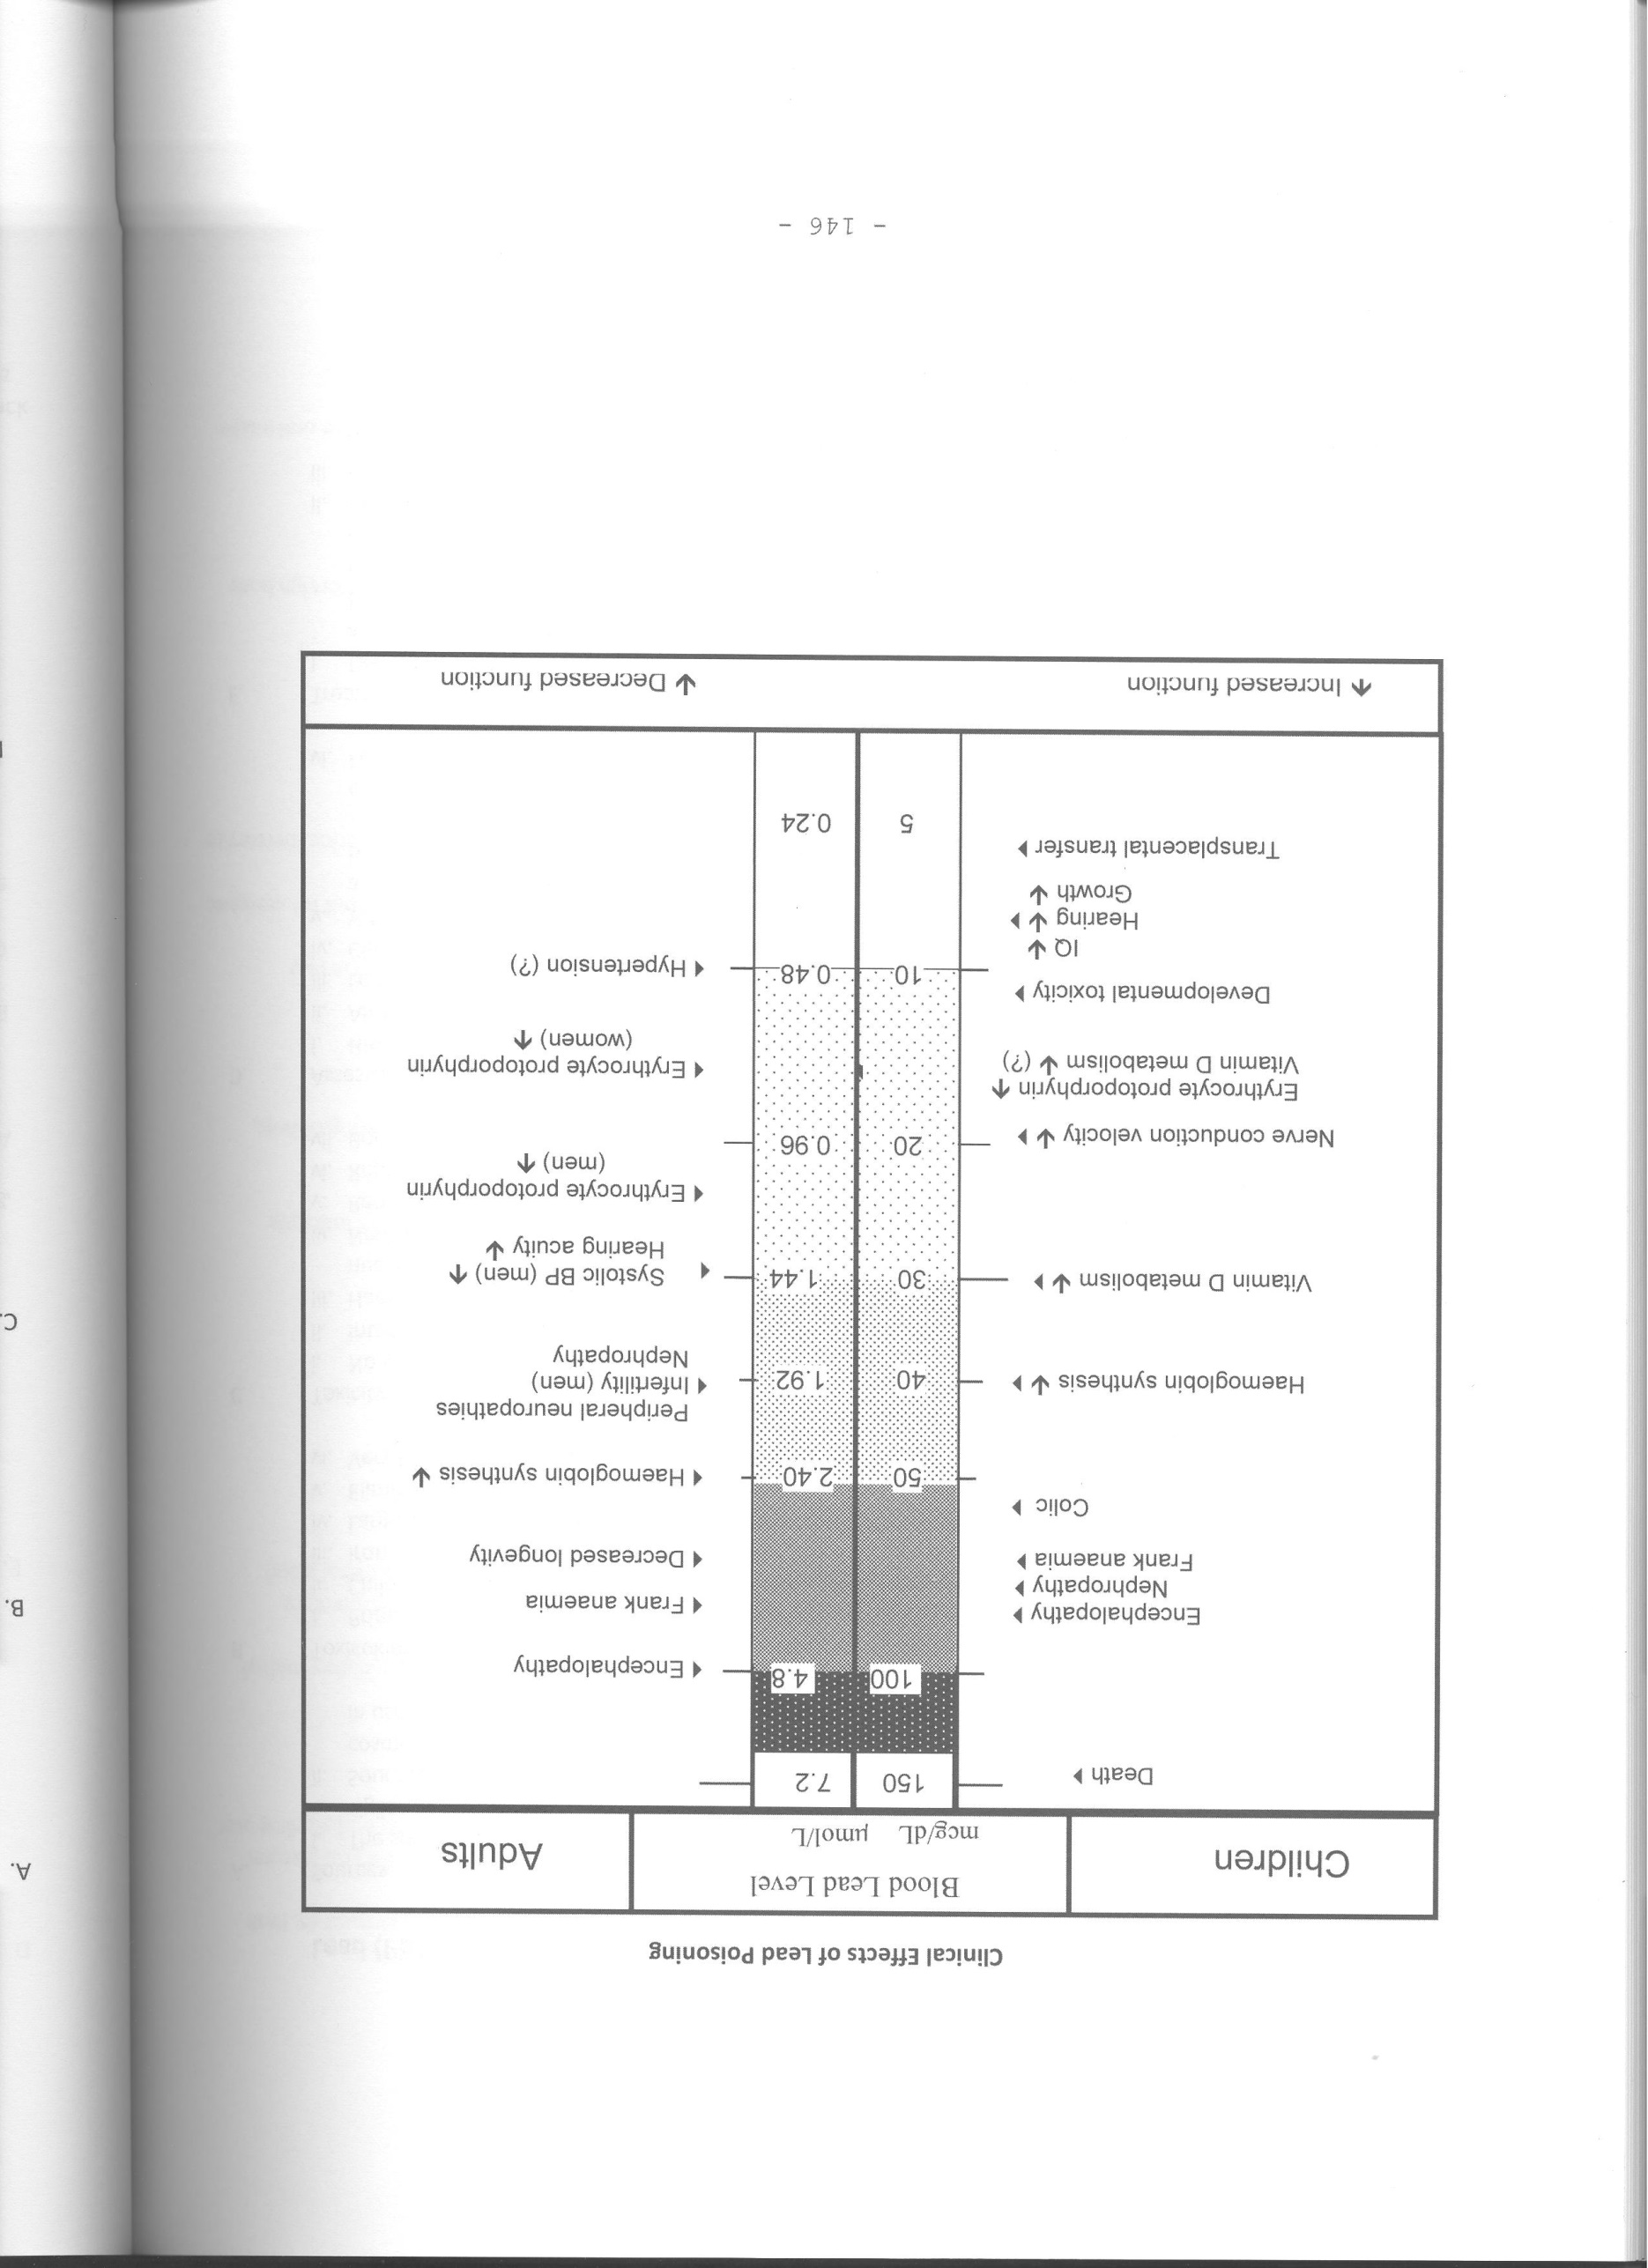

Slide 3
Different Scale of Blood Lead Level
Conventional unit = μg/dL
SI unit = μmol/L
5 μg/dL = 0.24 μmol/L

Slide 4
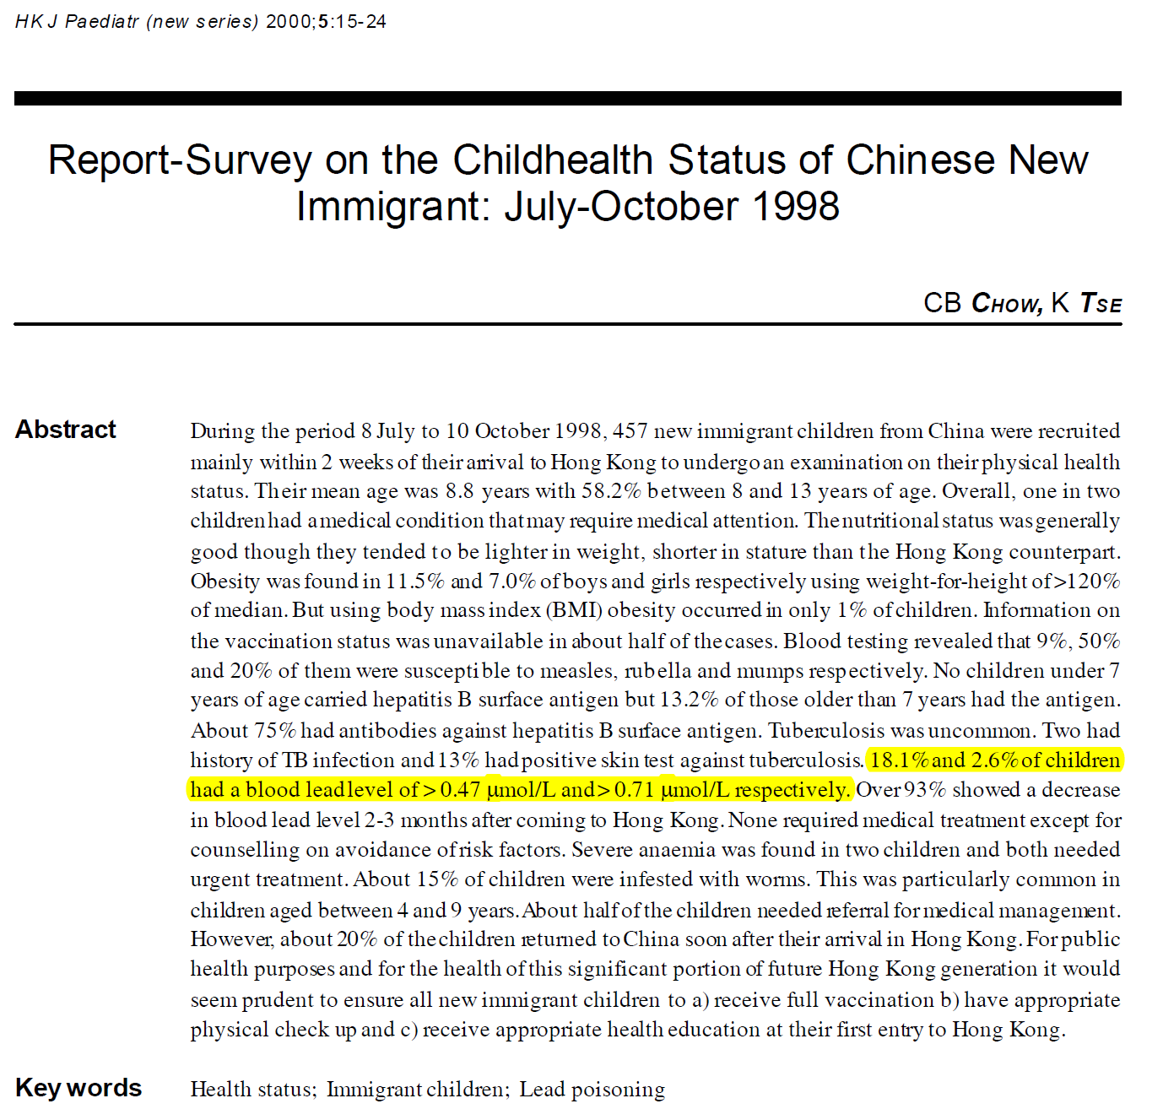

Slide 5
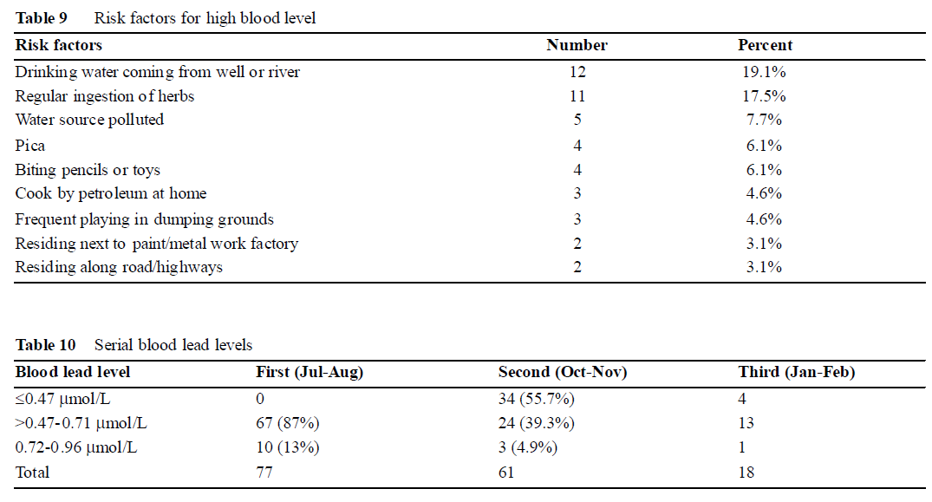
HK J Paediatr (new s er ies) 2000;5:15-24

Slide 6
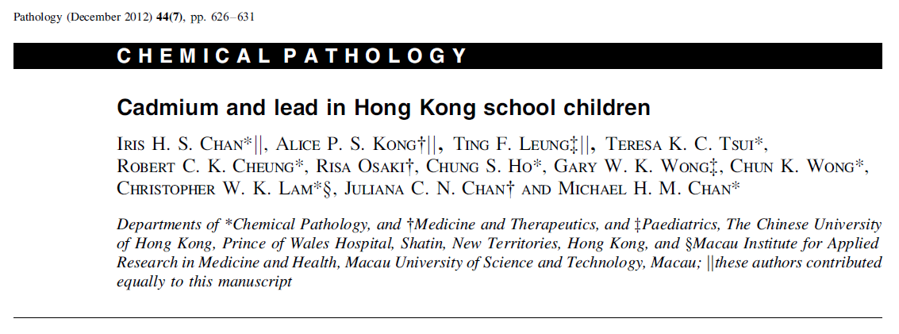

Slide 7
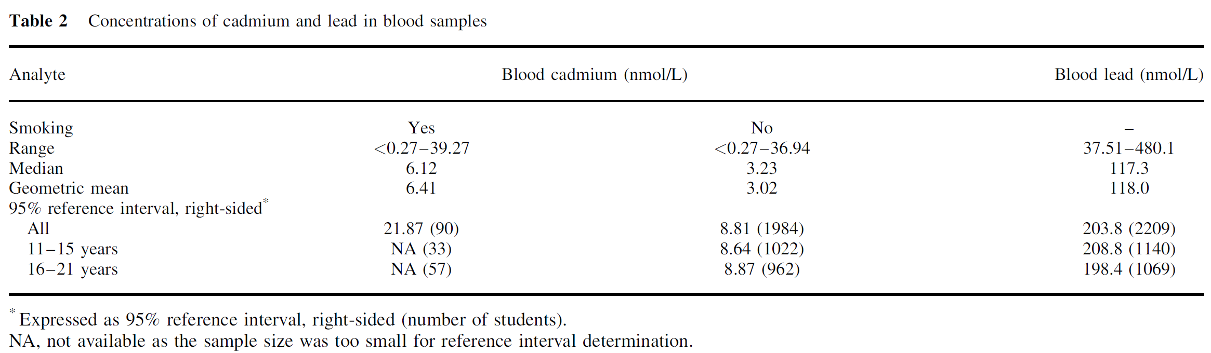
Blood Lead Levels in HK School Children

Slide 8
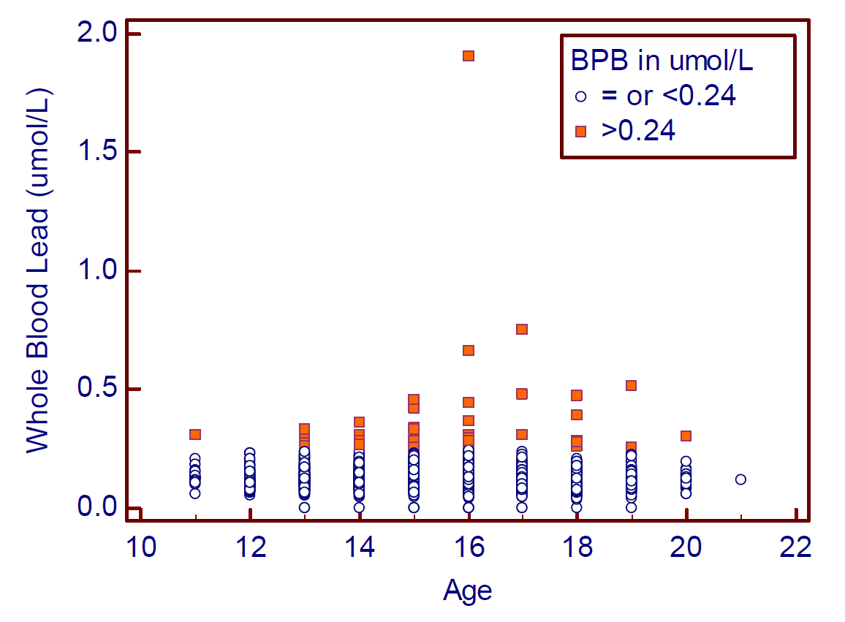

Slide 9
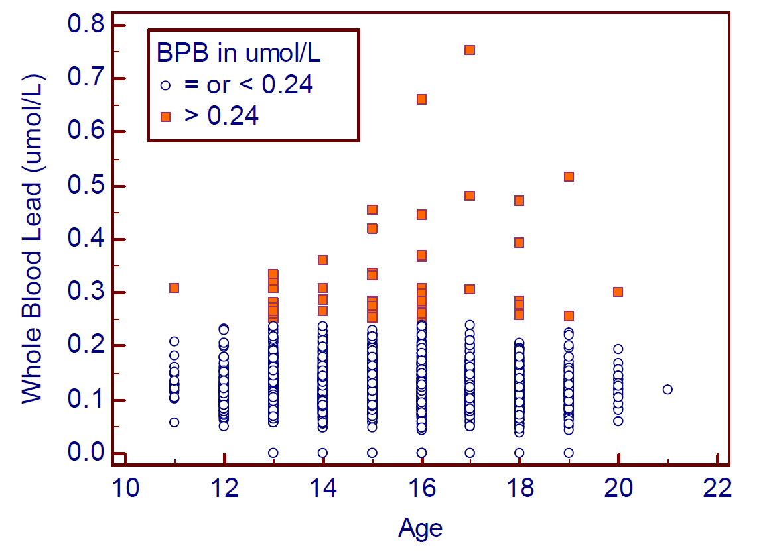

Slide 10
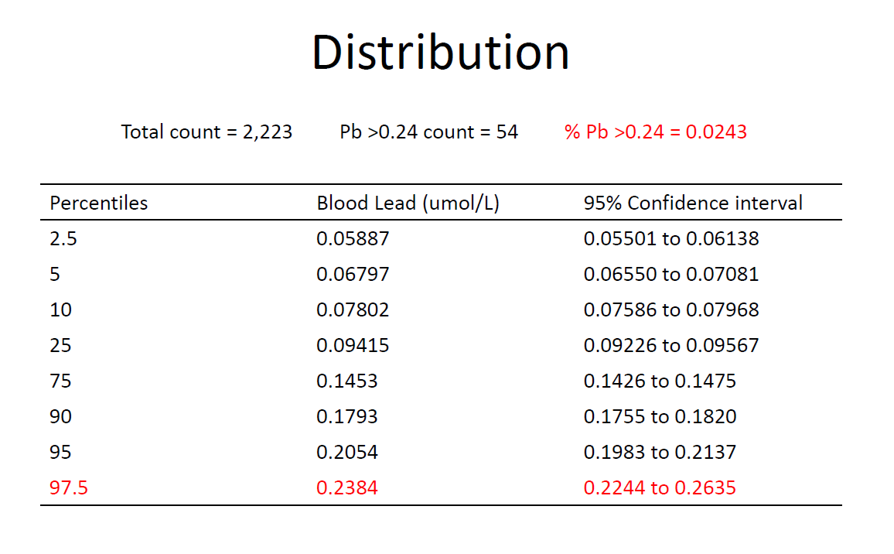

Slide 11
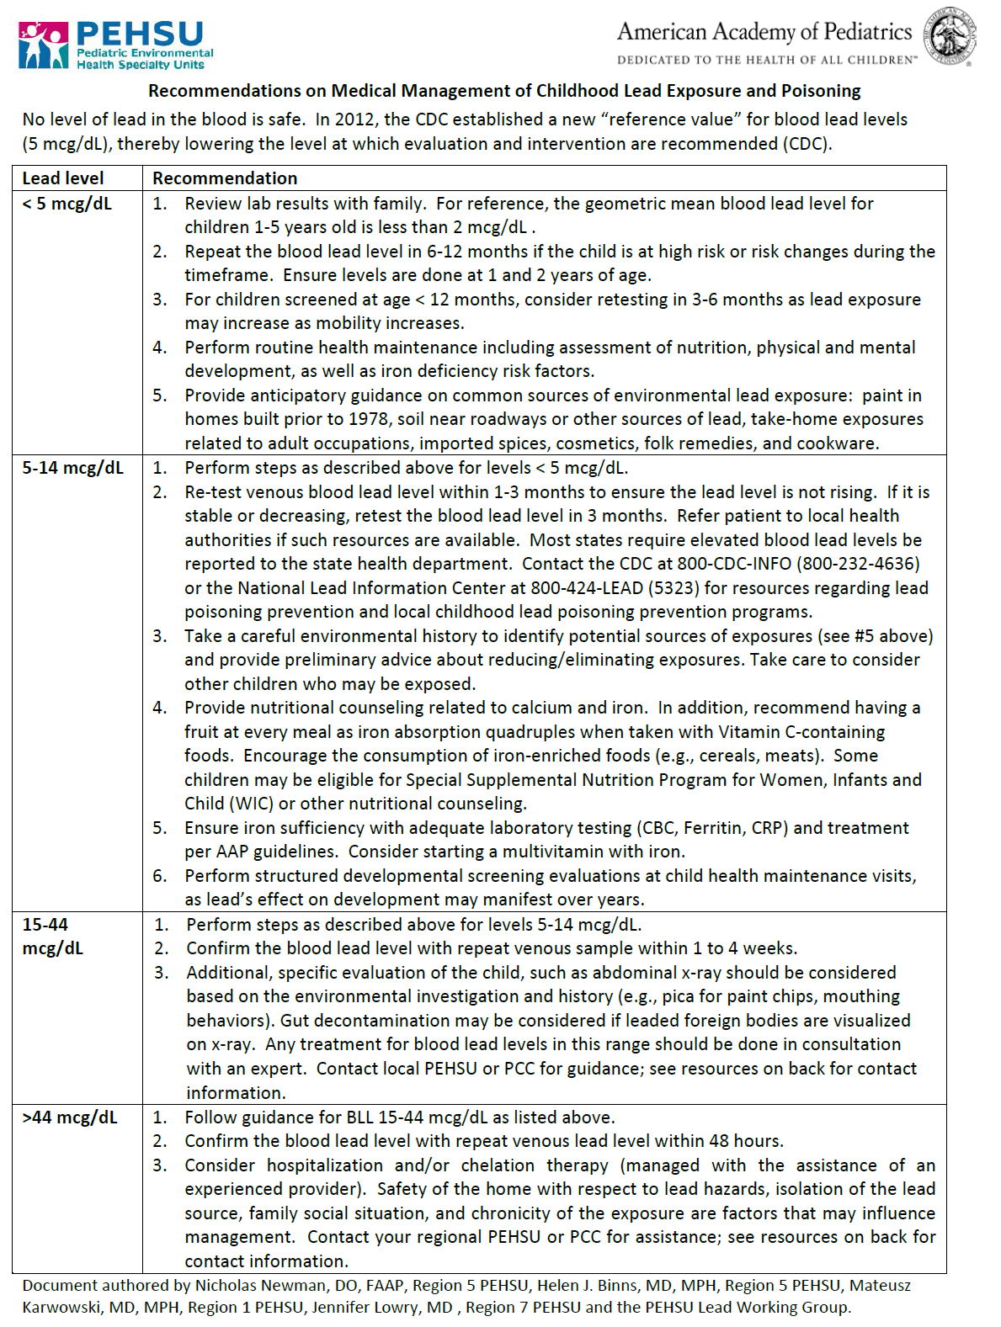

Slide 12
Laboratory Report of Screening Program
After detailed review of all the relevant literature by HATS, the following reference values for vulnerable subjects will be provided in the laboratory report:
Reference value: 5 mcg/dL (= 0.24 micromol/L)
Action level: >44 mcg/dL
  Indicating that the subject should be considered for chelation therapy
  Will need to be assessed by clinical toxicologist + pediatrician (for children)

Slide 13
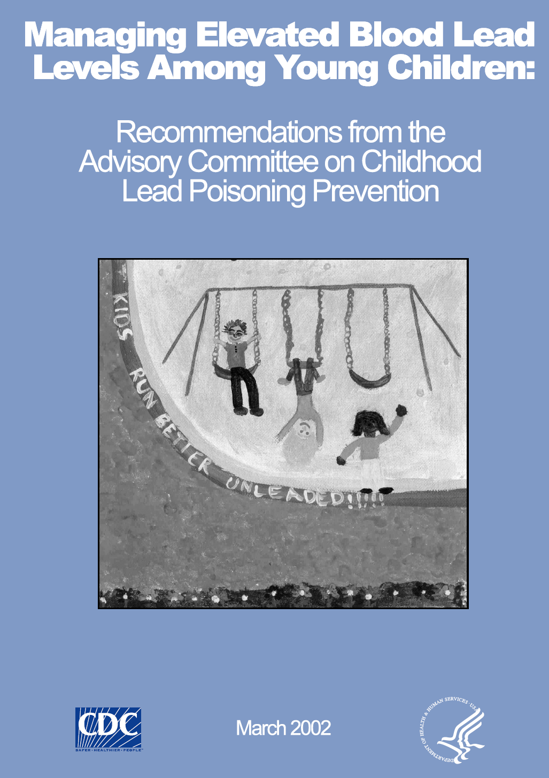

Slide 14
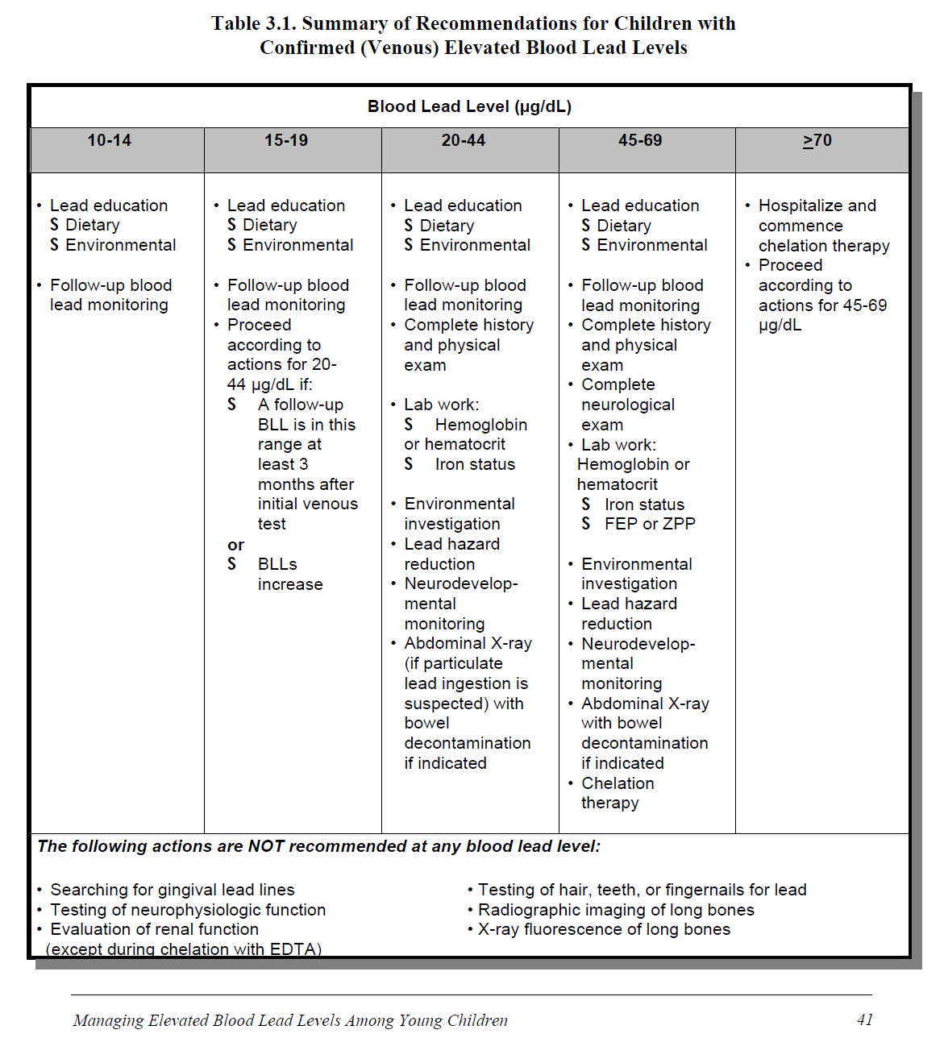

Slide 15
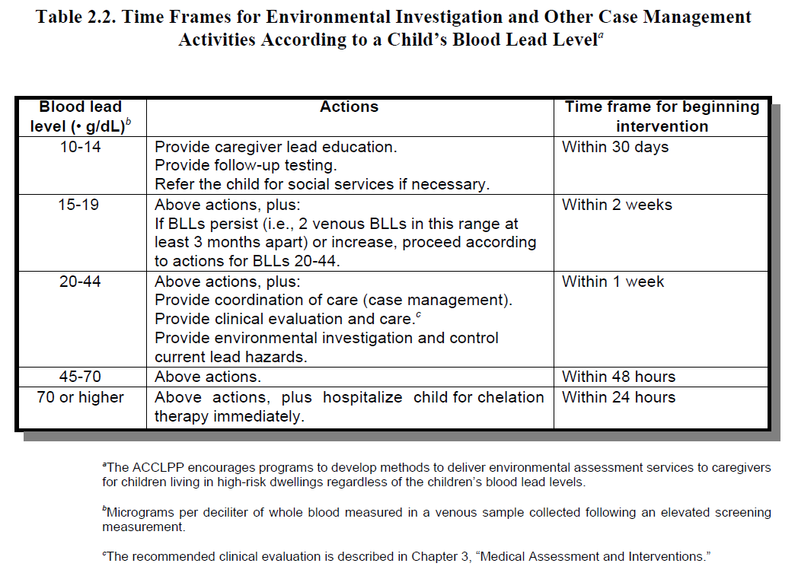

Slide 16
Action Plan for Pediatrics, Pregnant woman and lactating mothers
Depending on blood lead level (BLL):
BLL < 5 mcg/dL
  Considered normal, no further follow-up required
BLL 5 – 44 mcg/dL
  Need exposure assessment + counselling, remove exposure
  ? Repeat BLL immediately
  Monitoring of BLL in 1-3 months time (to evaluate trend) followed by assessment by pediatrician +/- toxicologist
BLL > 44 mcg/dL:
  Will be assessed jointly by Clinical Toxicologist + Pediatrician

Slide 17
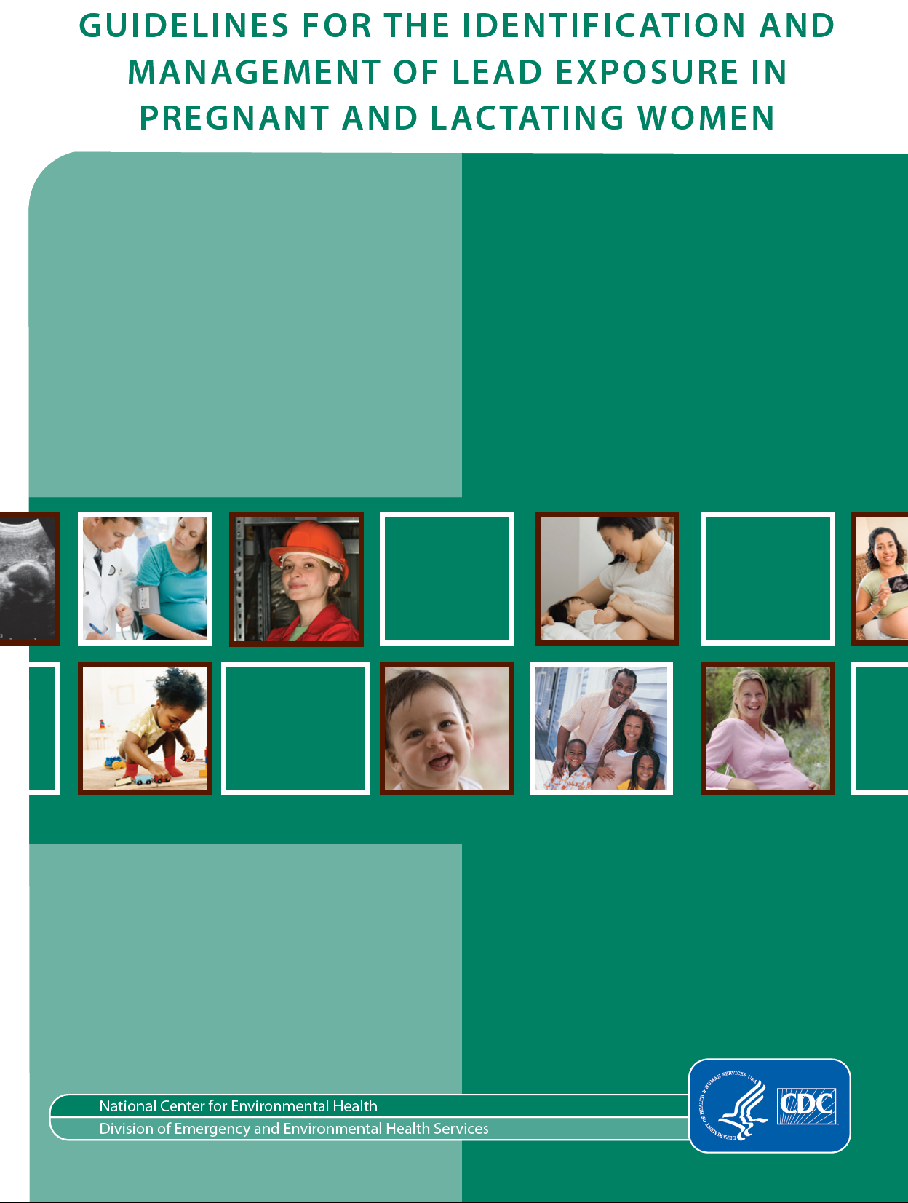

Slide 18
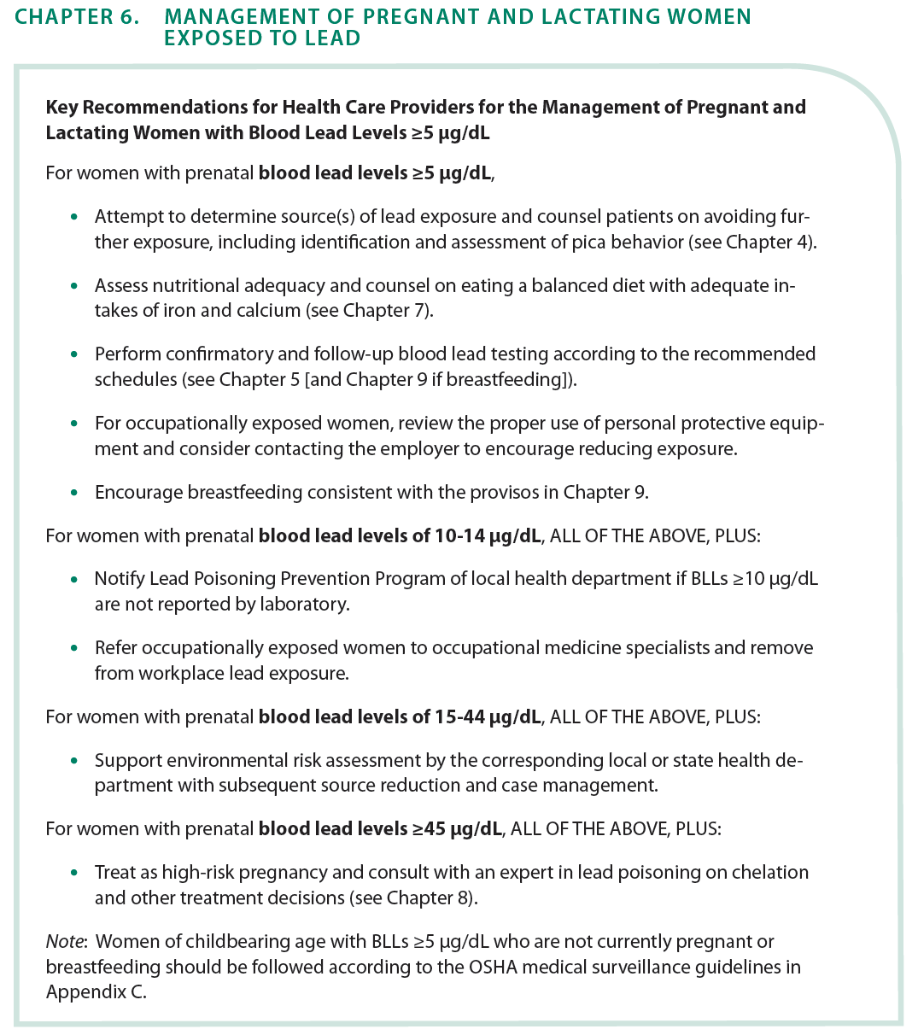

Slide 21
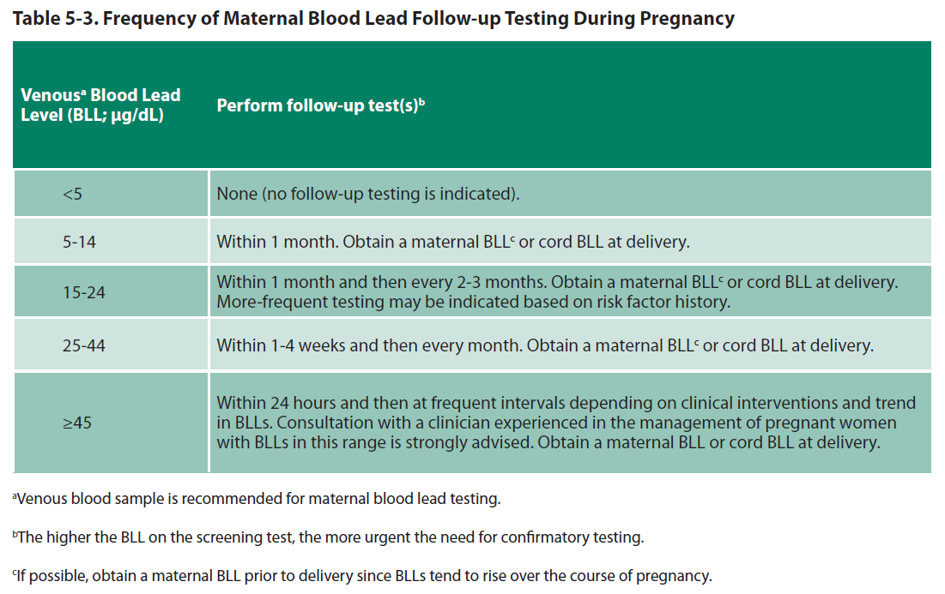

Slide 22
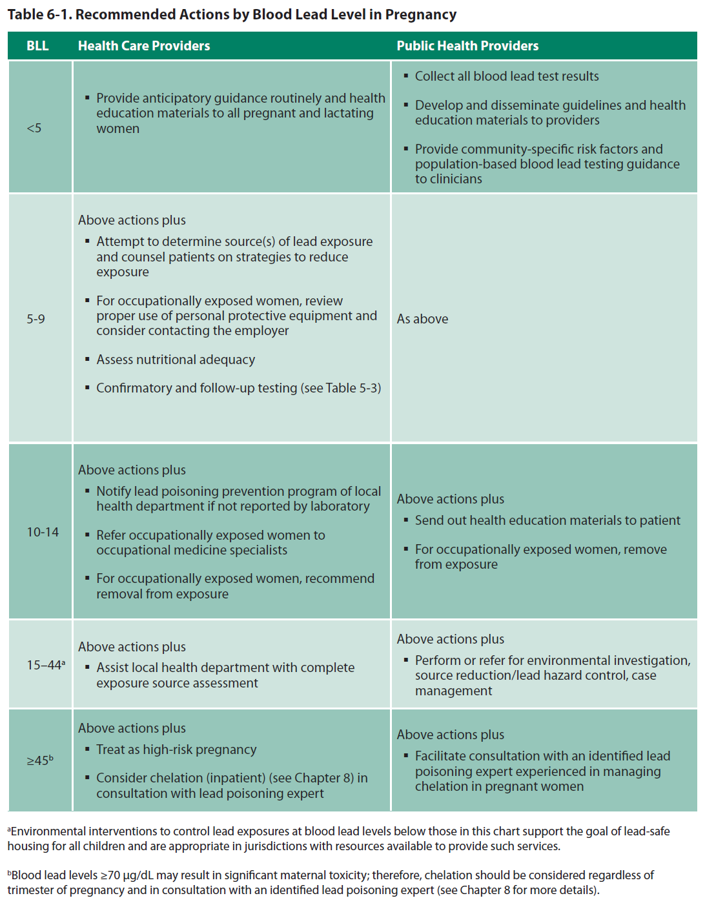

Slide 24
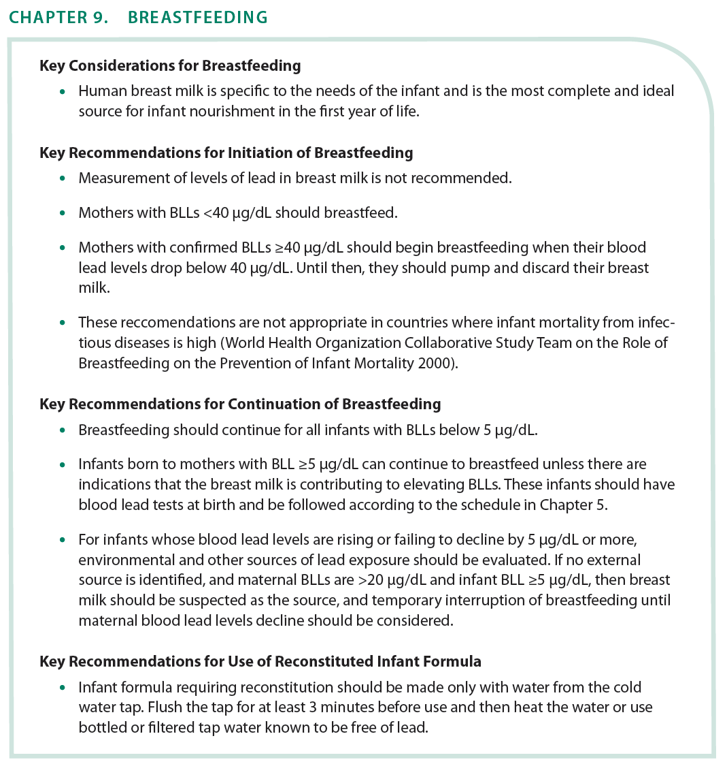

Slide 26
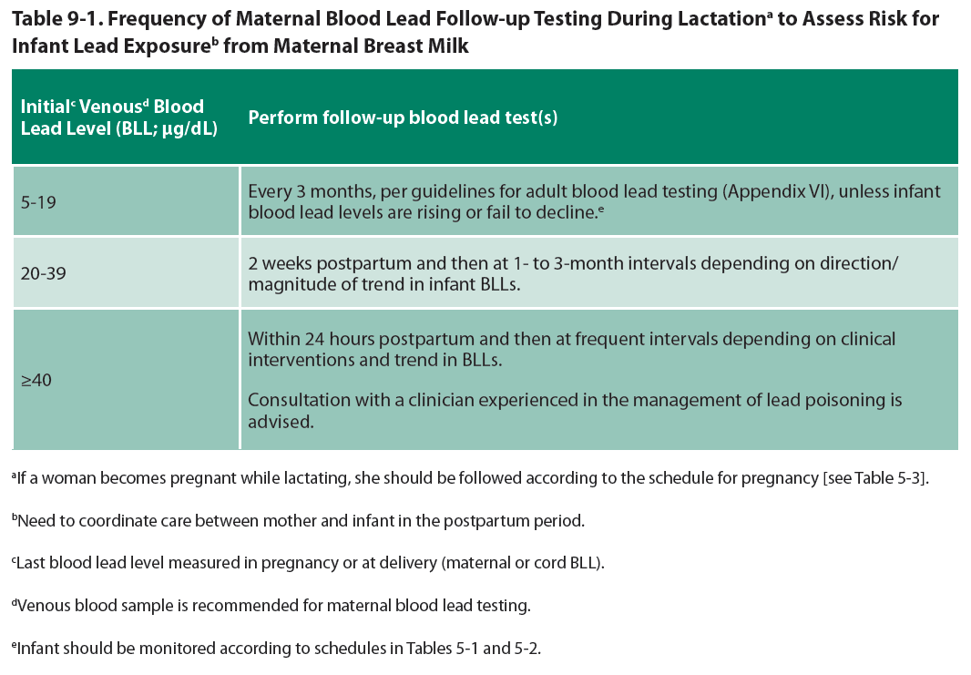

Slide 27
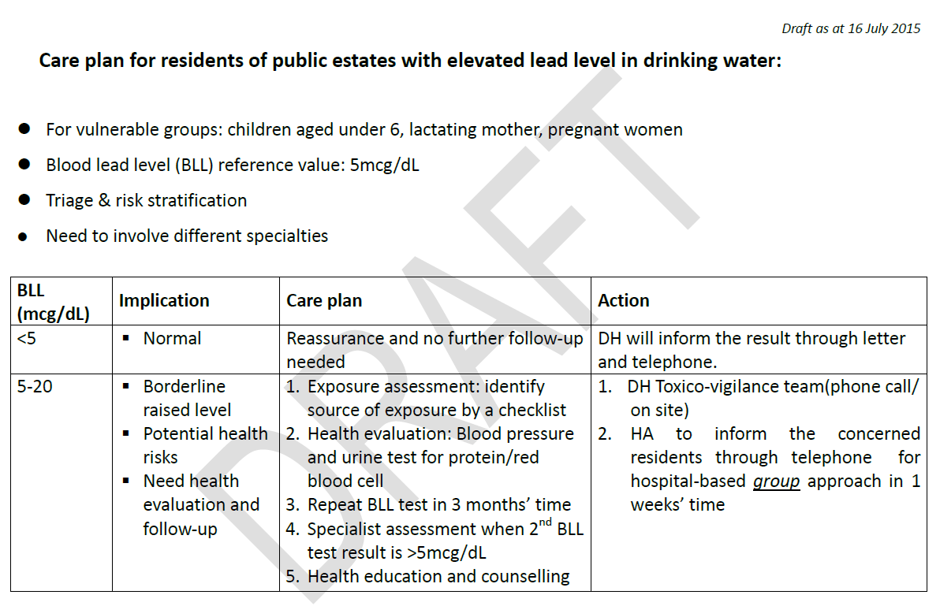

Slide 28
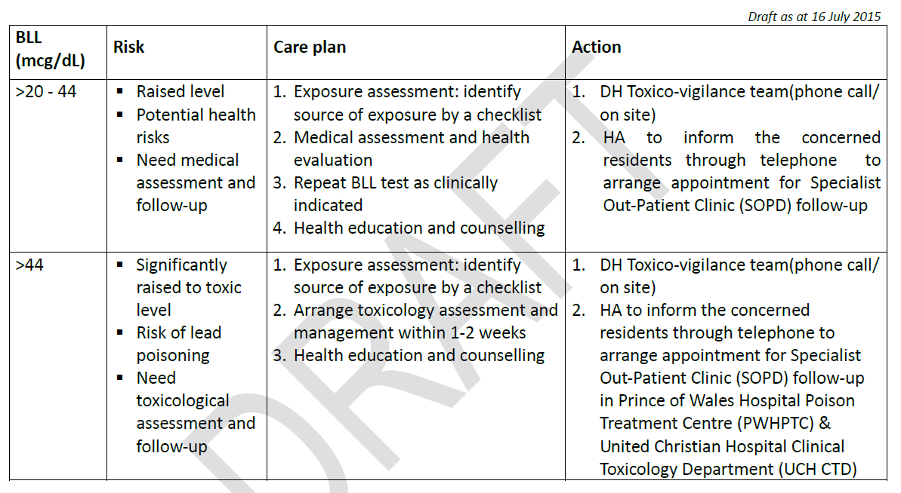

Slide 29
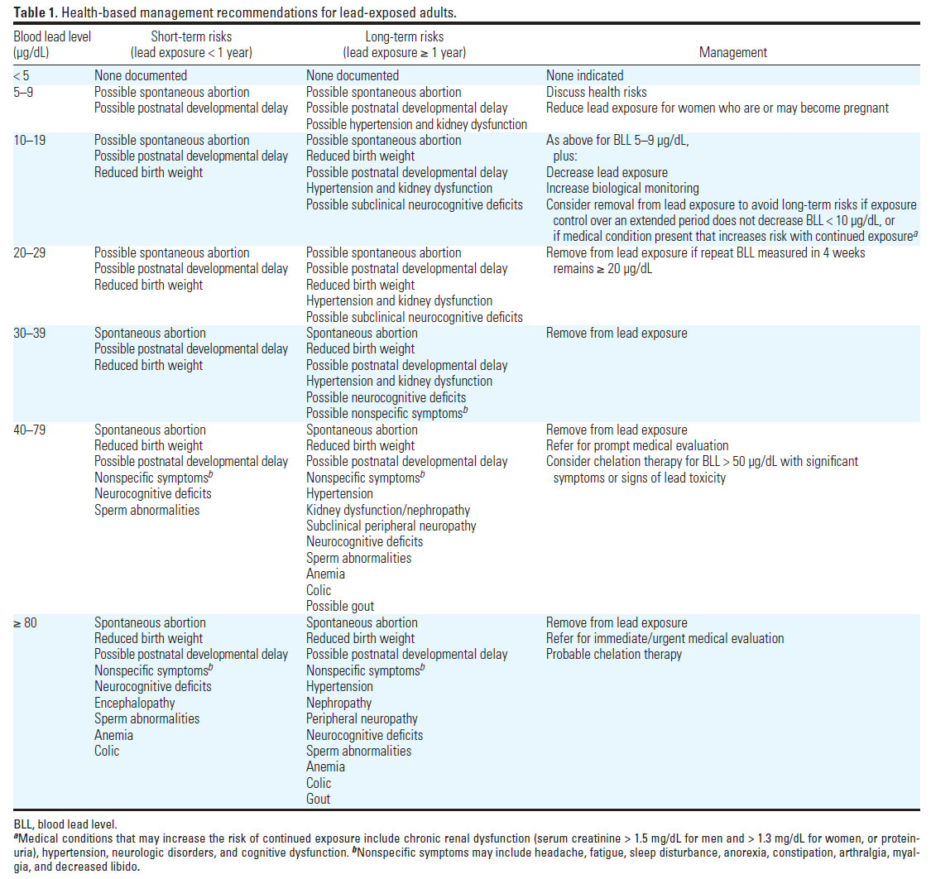

Slide 32
Plan of risk communication to public
每一百毫升(每分升)血有少於五微克鉛，這水平是正常(低於參考數值，對健康沒有明顯風險)
每一百毫升(每分升) 血有五至四十四微克鉛，這水平屬於血鉛偏高，(對身體有潛在健康風險，要作進一步健康評估及跟進)
每一百毫升(每分升) 血有四十四微克或以上鉛，這水平屬於血鉛嚴重偏高達中毒水平，(有可能出現臨床鉛中毒症狀，需要作臨床評估，繼而診斷是否鉛中毒)
臨床鉛中毒症狀主要爲神經發展系統、血液系統、心血管系統、泌尿系統、消化系統病徵。

